Slide 1

Microsoft Movie Studio Market Analysis and Strategy for Success
Randell Mwania

Slide 2

Problem
New studio research
Microsoft sees all the big companies creating original video content and they want to get in on the fun.
They have decided to create a new movie studio, but they don’t know anything about creating movies.
I am charged with exploring what types of films are currently doing the best at the box office.
I then must then translate those findings into actionable insights that the head of Microsoft's new movie studio can use to help decide what type of films to create.

Slide 3
Solution
identify top-grossing films
Identify top genres
Identifying the top-grossing films helps Microsoft gauge the industry standard in film making.
Identifying the top genres helps Microsoft make a decision on genres to prioritise.
Identify best runtime
Market trend
Identifying the best runtime minutes will help Microsoft moderate their runtime minutes effectively.
Researching the market trends will help Microsoft know more about the audience preferences in order to tailor-make them.

Slide 4
Project Overview
Business Problem
The aim of this project is to analyze the factors contributing to the success of movies at the box office and provide actionable insights for Microsoft's newly established movie studio.
Microsoft intends to enter the film industry but lacks expertise in movie production.
Therefore, understanding the current trends and successful strategies in the movie industry is crucial for making informed decisions and determining the most suitable genres for their film projects.
With the rise of major corporations producing their own unique video content, Microsoft recognizes the opportunity to establish its own movie studio.
However, lacking knowledge in the realm of filmmaking, Microsoft needs to gain insights into the types of films that are currently performing well at the box office.
The objective is to analyze market trends and identify key factors contributing to movie success, ultimately guiding Microsoft in developing a successful strategy for its entry into the movie industry.

Slide 5
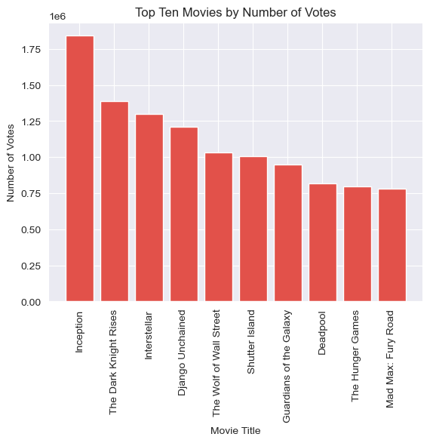
Top Ten Movies by Number of Votes
These movies with the most votes show that they captured the audience.
This shows the movies received the most feedback and are worth Microsoft's consideration for the new movie.
The findings show Inception as the most-voted movie, followed by The Dark Knight Rises, Interstellar, Django Unchained, The Wolf of Wall Street, Shutter Island, Guardians of the Galaxy, Deadpool, The Hunger Games and Mad Max: Fury Road.

Slide 6
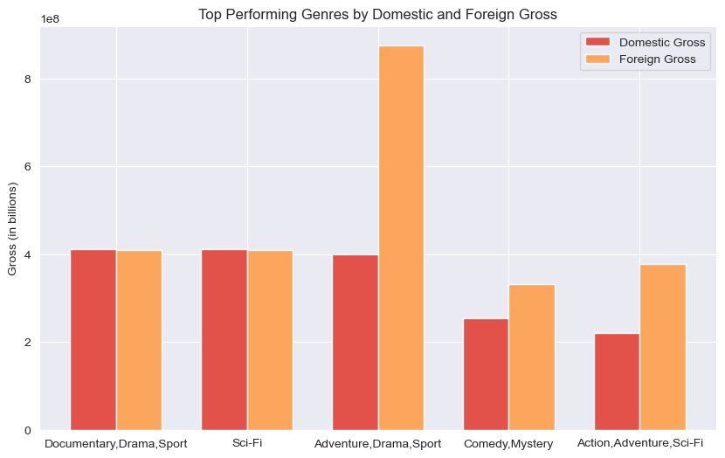
Top Performing Genres by Domestic and Foreign Gross
These are the genres with the highest domestic and foreign gross showing that they performed well in the market.
Microsoft should consider these top-grossing genres.

Slide 7
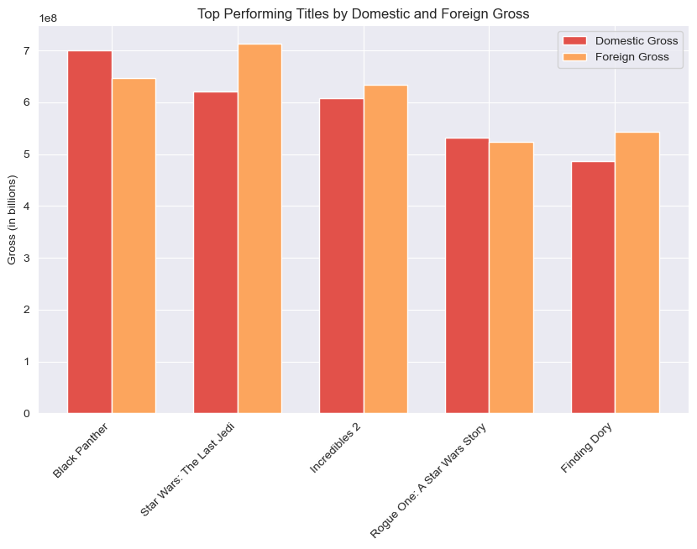
Top grossing titles
These are the titles with the highest domestic and foreign gross showing that they performed very well in the market.
Title | Domestic gross(in USD) | Foreign gross(in USD)
Black Panther | 700,100,000.0 | 646,900,000.0
Star Wars: The Last Jedi | 620,200,000.0 | 712,400,000.0
Incredibles 2 | 608,600,000.0 | 634,200,000.0
Rogue One: A Star Wars Story | 532,200,000.0 | 523,900,000.0
Finding Dory | 486,300,000.0 | 542,300,000.0

Slide 8
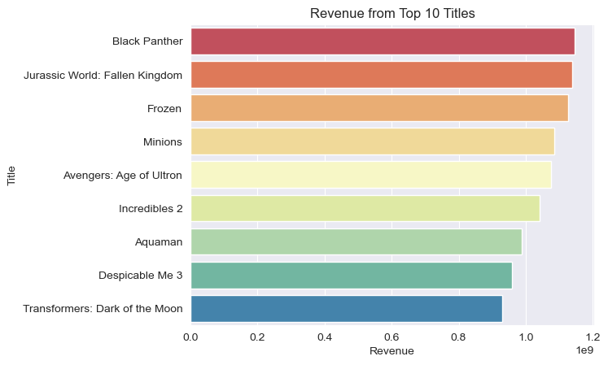
Titles with highest revenue
These are the titles with the highest revenue return showing that they earned very high returns compared to their production budget.
This shows they were a success base on their box office numbers.

Slide 9
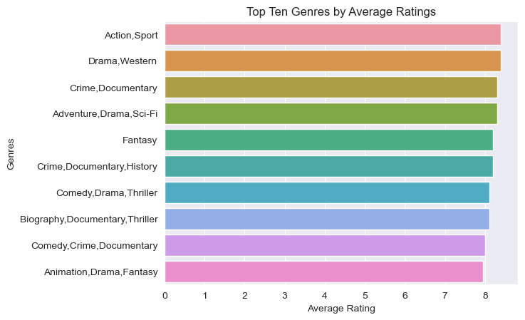
Titles with highest average rating
These are the genres with the highest revenue return showing that they were relatively highly rated.
This shows they were the most rated hence most preferred by viewers.

Slide 10
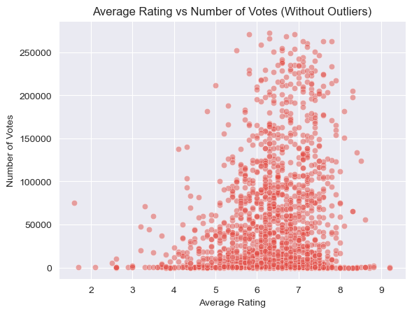
average rating of the titles against the number of votes they received
The titles with a high number of votes were relatively highly rated.
It was also noted that there were titles with a considerable amount of votes that were poorly rated.

Slide 11
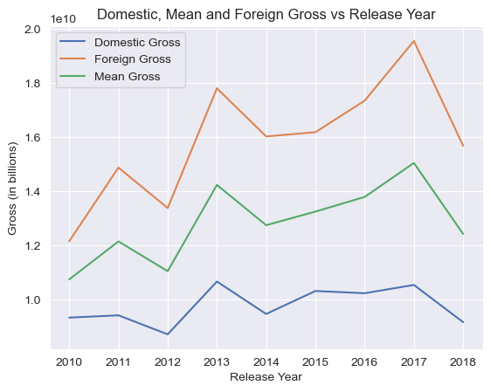
average rating of the titles against the number of votes they received
From the domestic, mean and foreign gross against release Year graph above, we can see the movies are more successful in the foreign market over the years than in the domestic market.
This can be attributed to the large foreign population compared to the relatively smaller domestic population.

Slide 12
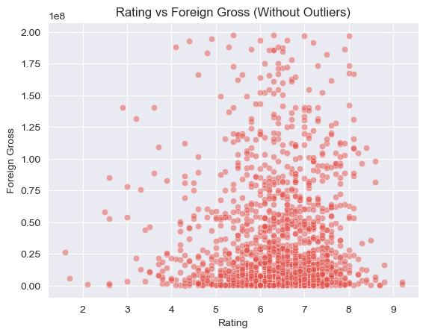
average rating of the titles against the foreign gross
From the rating against foreign gross, we can see that not only did the movies with a relatively higher rating gross more income in the foreign market but some poorly rated movies had a relatively high foreign gross as well.
This can be attributed to the large foreign population compared to the relatively smaller domestic population.

Slide 13
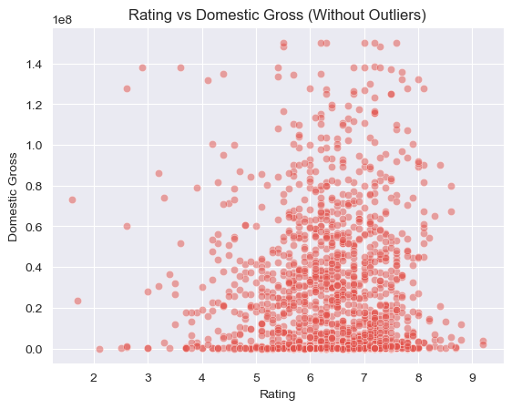
average rating of the titles against the domestic gross
From the rating against domestic gross, we can see the movies with a relatively higher rating grossed more income in the domestic market.

Slide 14
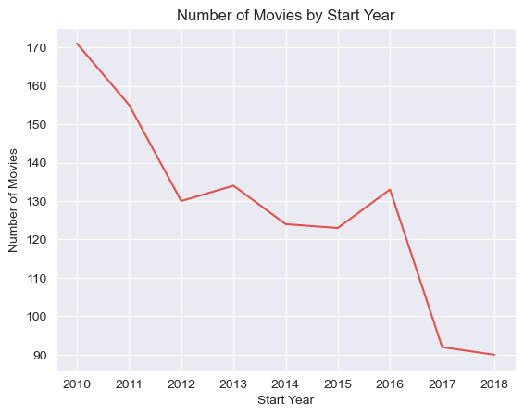
Number of Movies by Start Year
From the Number of Movies by Start Year, we can see the number of movies being released has dropped.

Slide 15
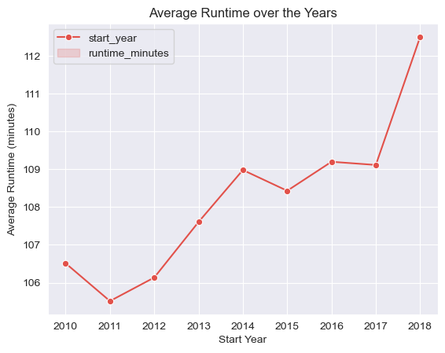
Average runtime over the years
The runtime minutes of the movies can be seen rising.
This shows the change in the audience preference.

Slide 16

films that amassed the highest revenue
Primary Title | Revenue | Production Budget
Black Panther | 1,147,000,000 | 200,000,000
Jurassic World: Fallen Kingdom | 1,139,500,000 | 170,000,000
Frozen | 1,126,400,000 | 150,000,000
Minions | 1,085,400,000 | 74,000,000
Avengers: Age of Ultron | 1,074,800,000 | 330,600,000
Incredibles 2 | 1,042,800,000 | 200,000,000
Aqua man | 987,800,000 | 160,000,000
Despicable Me 3 | 959,800,000 | 75,000,000
Transformers: Dark of the Moon | 928,800,000 | 195,000,000

Slide 17

conclusion
In conclusion, the project provides valuable insights into the current trends and success factors in the movie industry. By leveraging the analysis of market data and understanding audience preferences, Microsoft can make informed decisions and develop a successful strategy for its movie studio. The recommendations to invest in high-rated movies, expand international distribution, and optimize movie runtimes align with industry trends and can contribute to Microsoft's success in the film industry.
The visualizations provided in the project showcase key findings and enhance the understanding of the analysis. Visual representations of data are effective tools for conveying information and patterns, enabling Microsoft's decision-makers to grasp the insights quickly. By leveraging these insights and recommendations, Microsoft can position itself strategically in the movie industry, leveraging its resources, and making informed decisions that align with audience preferences and market trends. With a well-informed market analysis and a solid strategy in place, Microsoft's movie studio has the potential to achieve significant success and establish itself as a prominent player in the entertainment industry.

Slide 18
recommendation
Through exploratory data analysis, this project aims to identify market trends and key factors influencing box office success. The analysis provides actionable insights and recommendations for Microsoft's movie studio strategy. The following recommendations are based on the findings:
Invest in high-rated movies: The analysis reveals a positive correlation between movie ratings and box office success. Microsoft should prioritize producing and acquiring movies with higher average ratings. This can be achieved by investing in talented filmmakers, compelling scripts, and quality production to ensure audience appeal.
Expand international distribution: The analysis shows that foreign gross significantly impacts overall box office success. Microsoft should consider expanding international distribution efforts through strategic partnerships with international distributors, content localization, and targeted marketing campaigns. This will allow Microsoft to tap into the global market and maximize revenue potential.

Slide 19
recommendation
Optimize movie runtime: The analysis indicates a decreasing trend in movie runtimes over the years. Microsoft should carefully consider the optimal runtime of their movies based on audience preferences and market trends. Striking a balance between engaging storytelling and meeting audience expectations is crucial. By optimizing movie runtimes, Microsoft can deliver captivating and well-paced movies that resonate with the audience.
By following these recommendations, Microsoft can enhance its competitive position, increase the likelihood of achieving positive business outcomes, and establish a strong presence in the movie industry.

